Slide 1

Florida Geological Survey
Using QGIS to Generate Web-Ready
3D Visualizations
Seth Willis Bassett, GISP
Levi M. Hannon
Katherine M. White
Florida Geological Survey
Florida Department of Environmental Protection

Slide 2
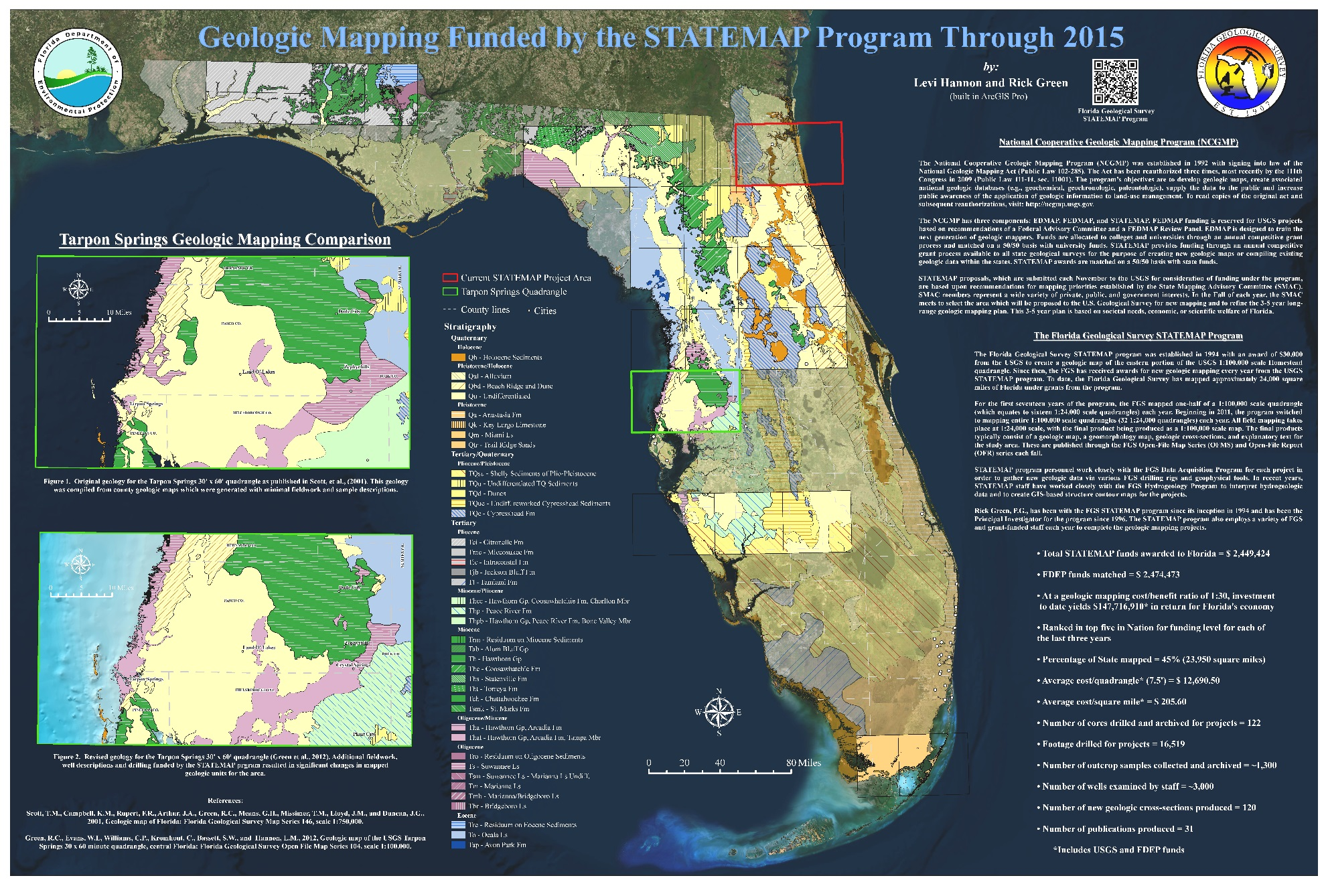
Who are we?

Slide 3
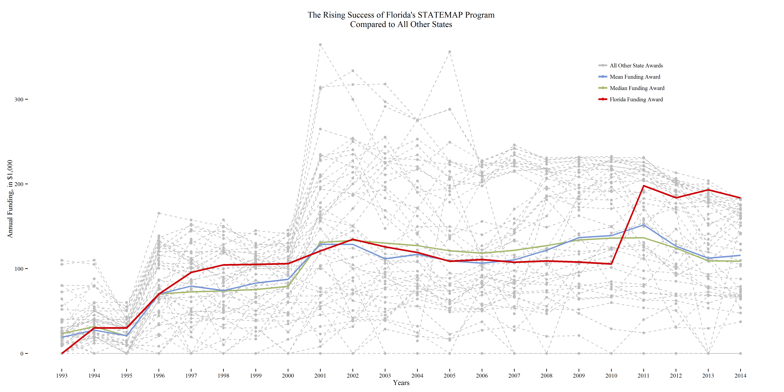
Florida’s STATEMAP

Slide 4
Motivations
How do we generate and share 3D content easily?
How do we take STATEMAP and FGS geologic data to the next level and remain competitive?

Slide 5
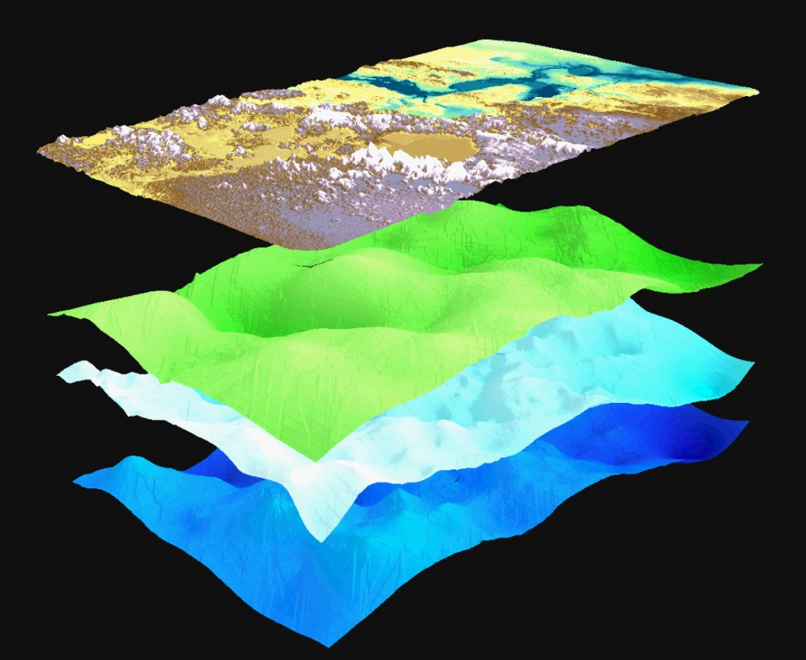
Solutions
ArcScene
Pros:
Available to most GIS analysts
Cons:
Low quality 3D visualizations
Only ‘web ready’ format is VRML
Originally Specified 1994
Superseded by X3D in 2004

Slide 6
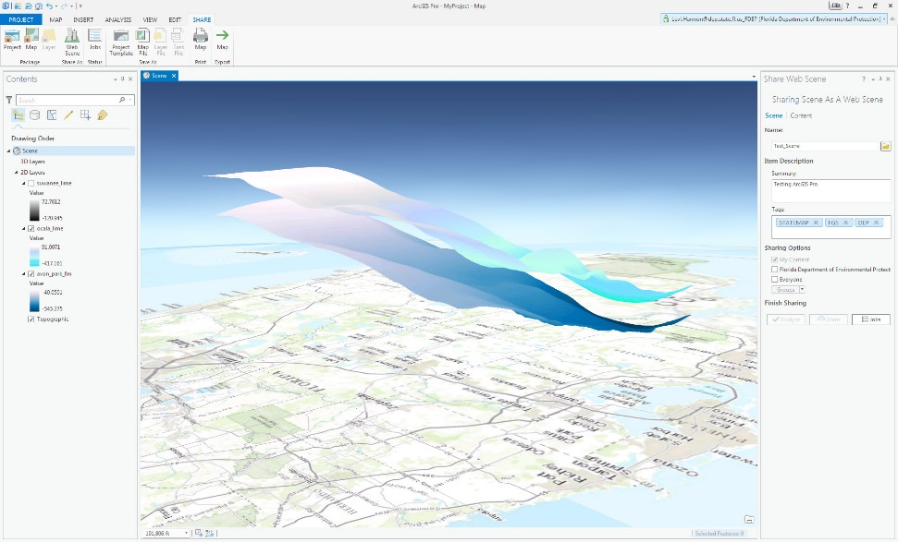
Solutions
ArcGIS Pro
Pros:
Available to most GIS analysts
Integration of 2D and 3D visualization
Web Ready Exports to ArcGIS Online
Cons:
Buggy
Only positive z-values are supported

Slide 7
Solutions
QGIS
Pros:
100% free
Can generate web-ready content using plugins
Mobile compatible
Cons:
Limited resolution
Good data preparation is essential

Slide 8


Software Stack
ArcGIS 10.2.2 (Preparation)
QGIS 2.10.1 Pisa
Minoru Akaqi’s Qgis2threejs plugin (v1.4)
WebGL
three.js

Slide 9
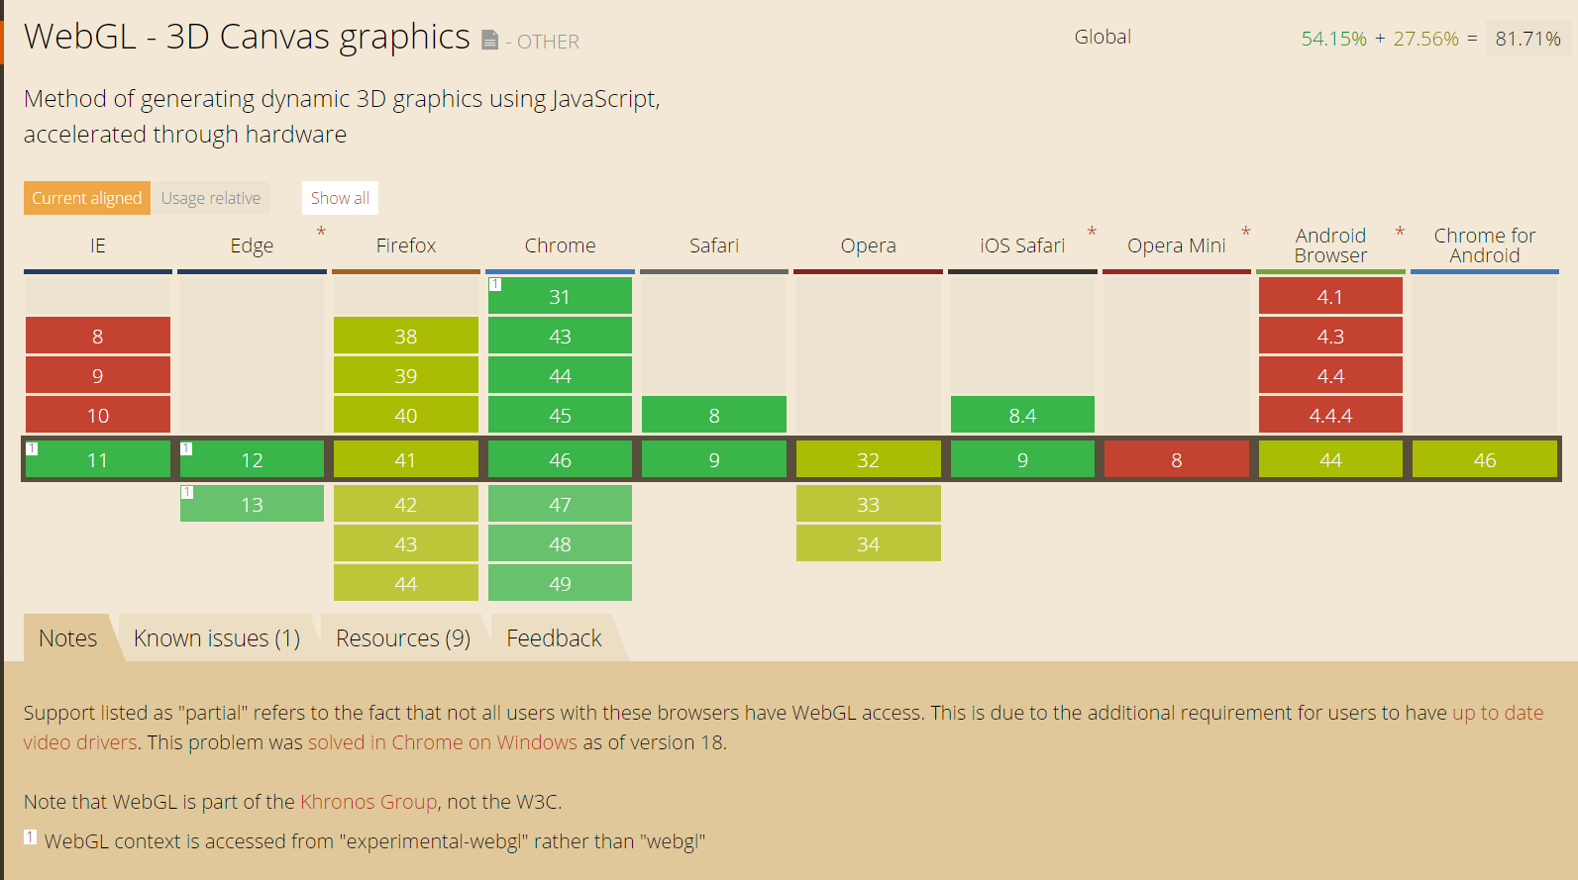
WebGL Compatibility
Link to Source

Slide 10
Data Preparation: Rasters
QGIS Requires:
Single Band .tif elevation raster
Optional RGB image to drape over elevations
Additional Raster Surfaces

Slide 11
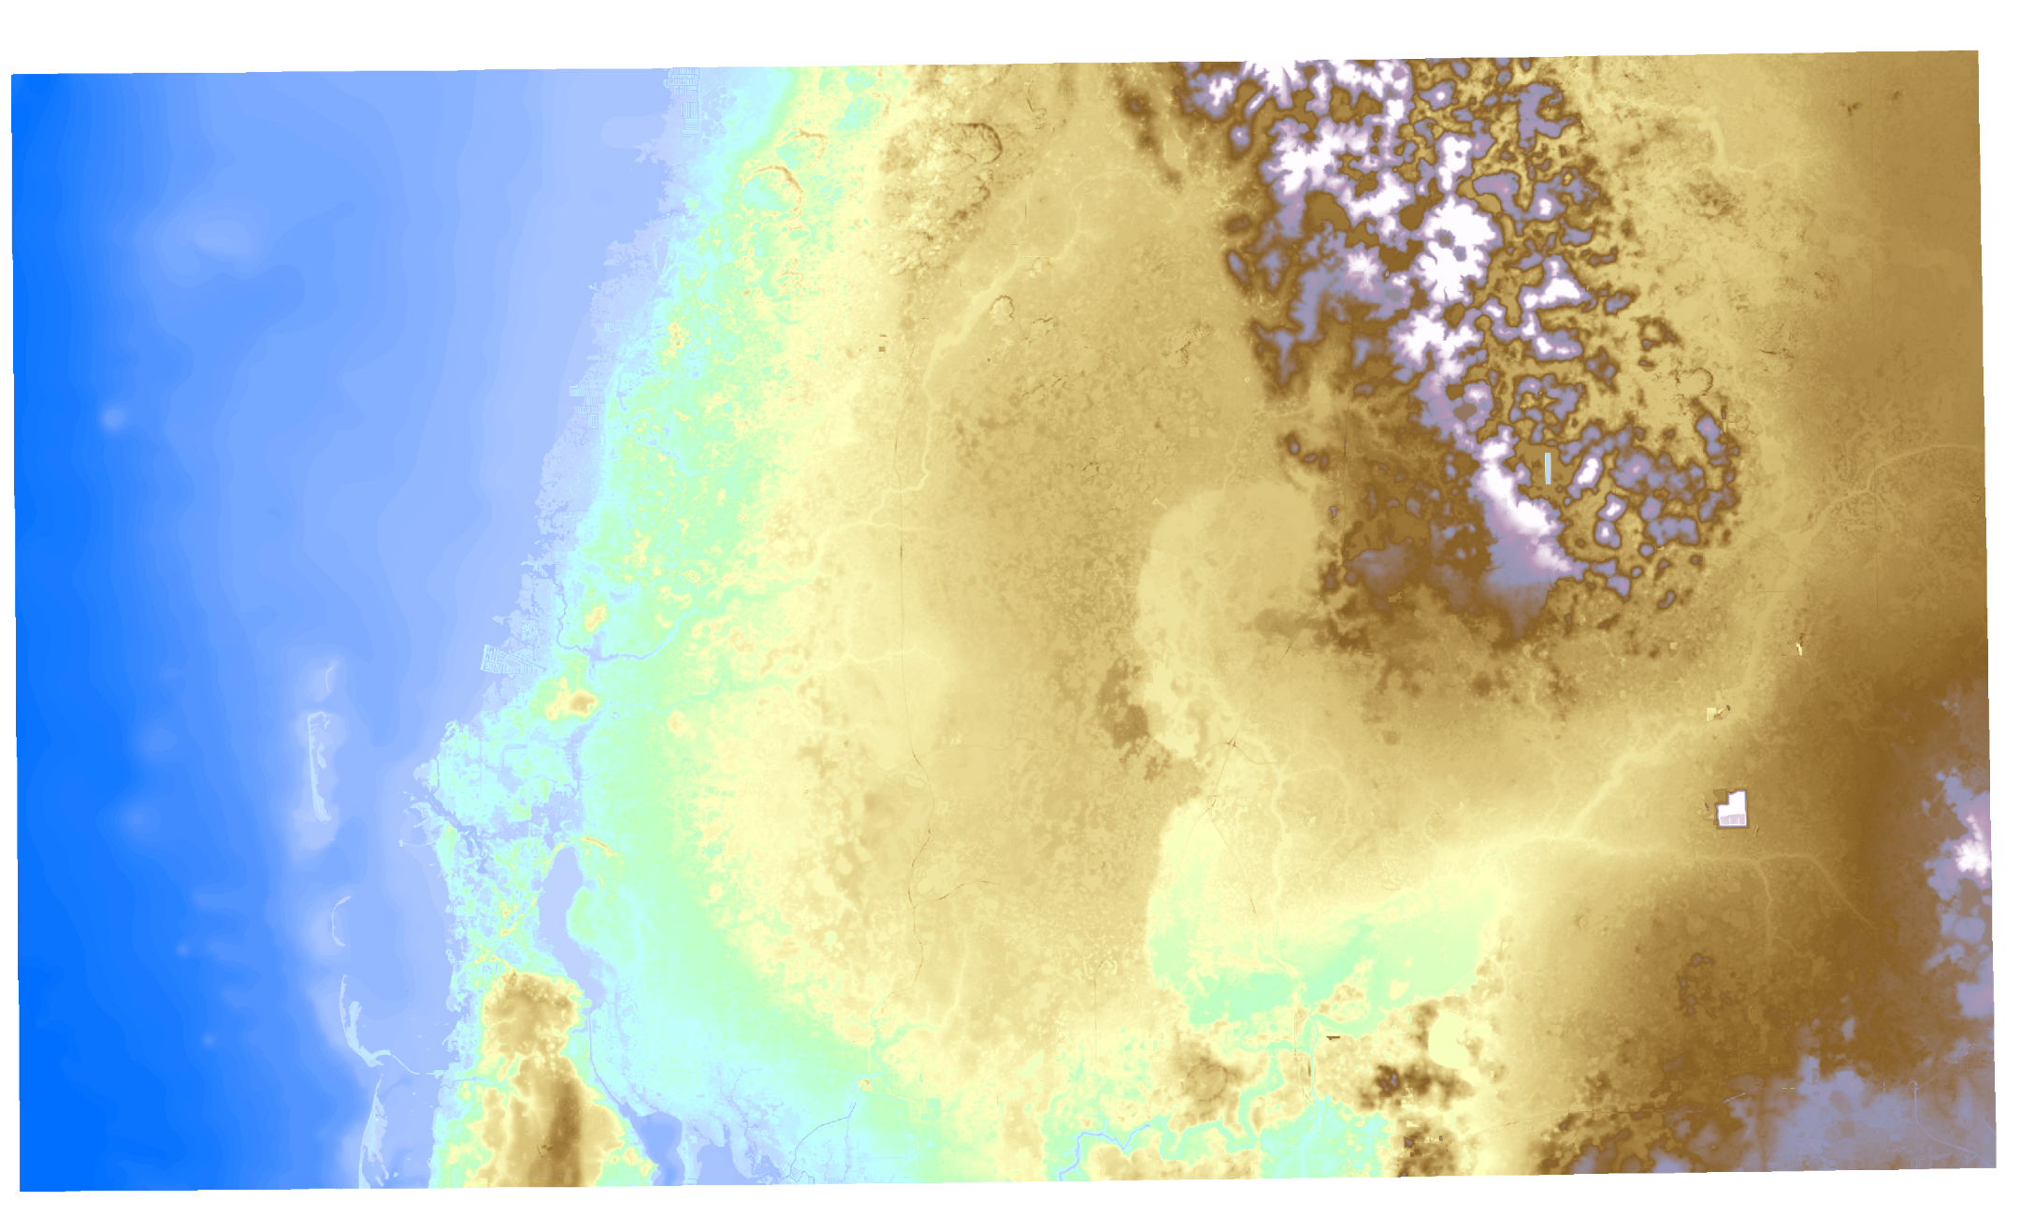
Data Preparation: Rasters

Slide 12
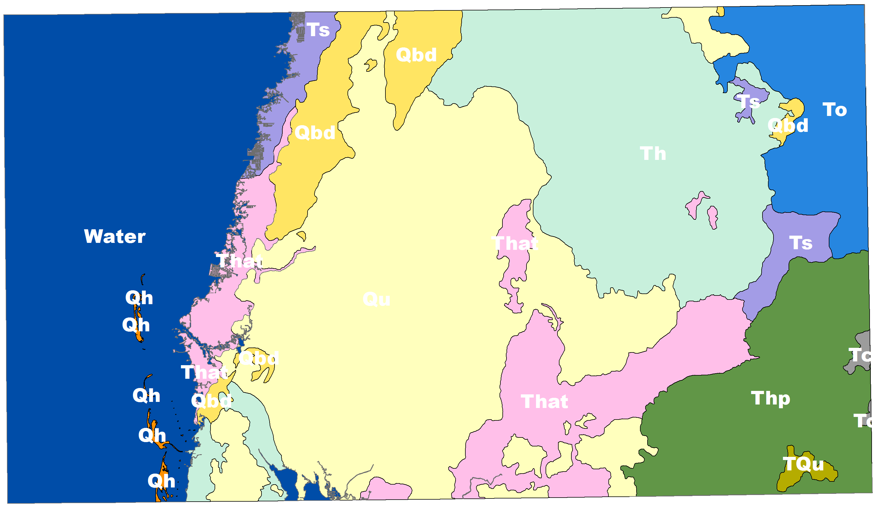
Data Preparation: Rasters

Slide 13
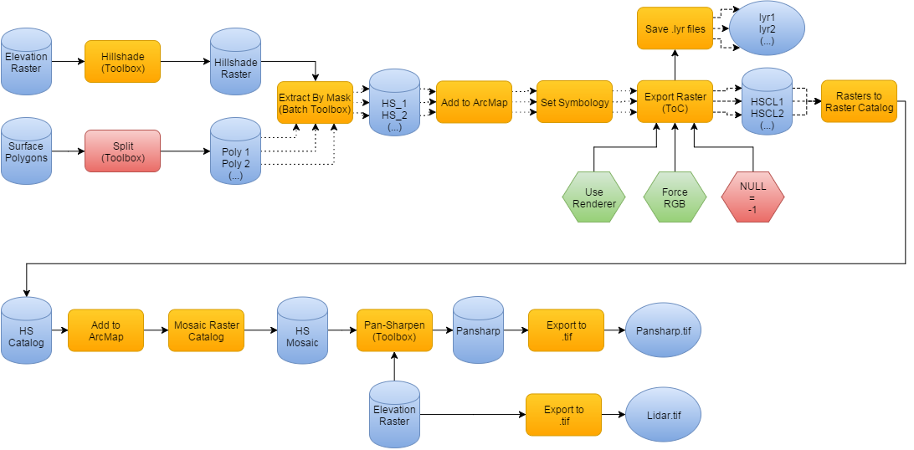
Data Preparation: Rasters

Slide 14
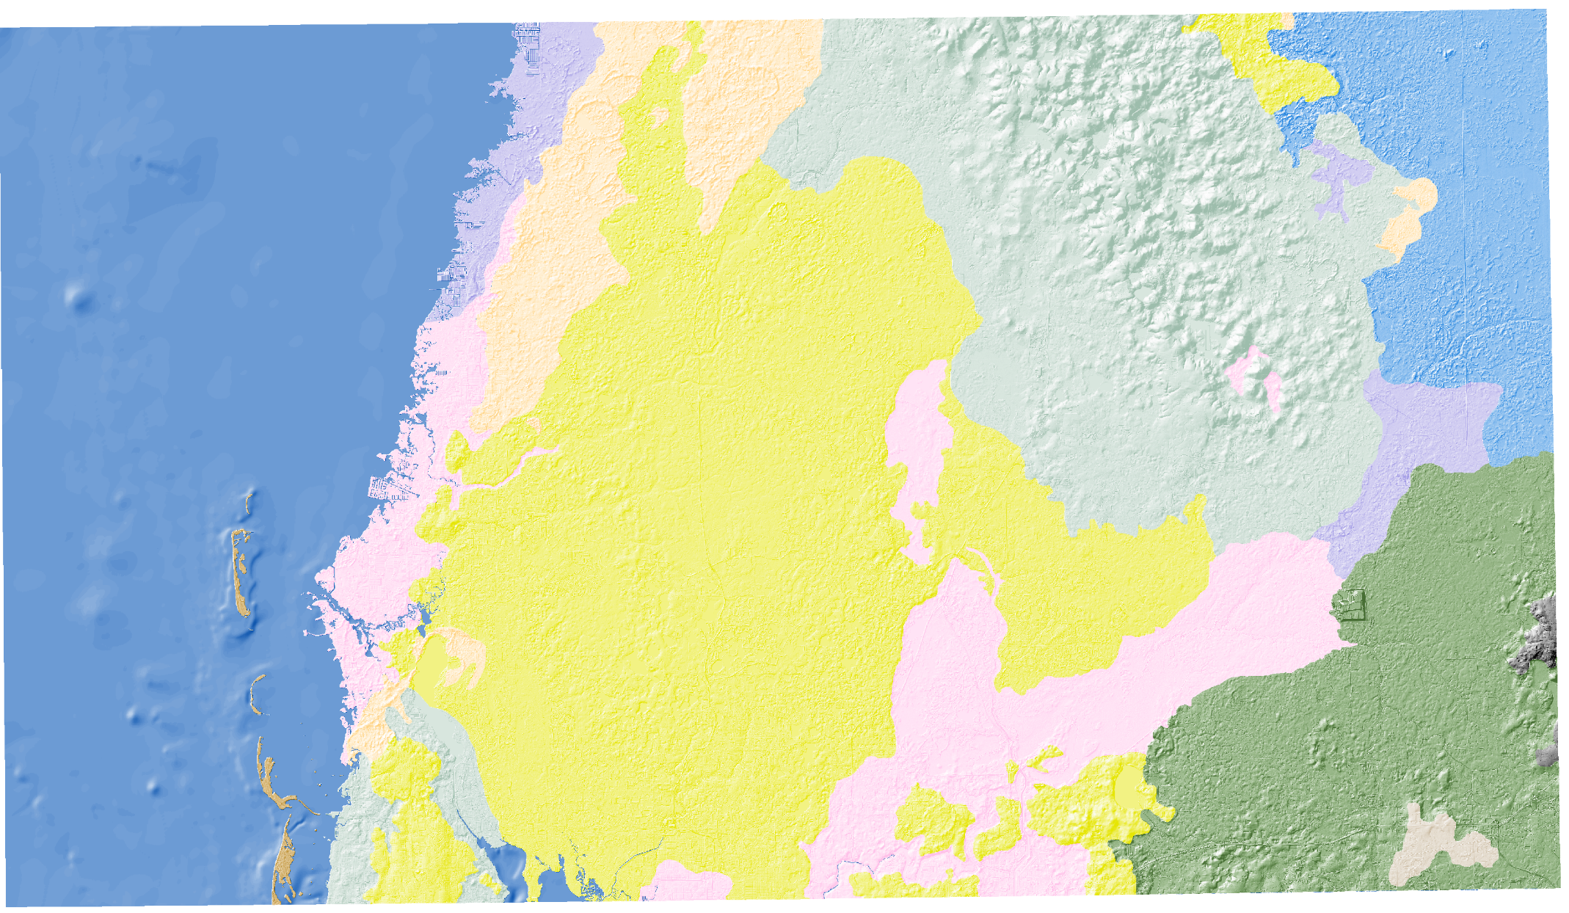
Data Preparation: Rasters

Slide 15
Data Preparation: Rasters

Slide 16
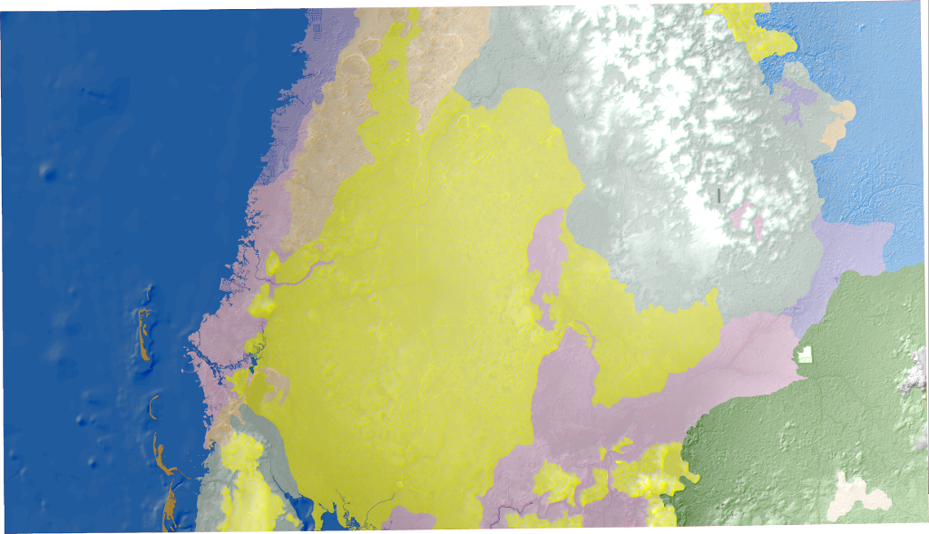
Data Preparation: Rasters

Slide 17
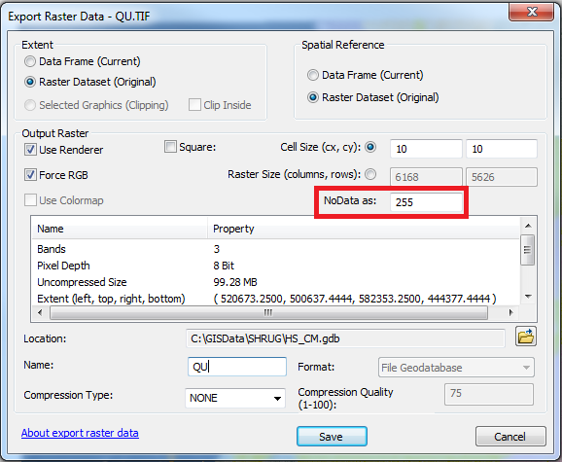
Gotchas: Setting Null Values

Slide 18
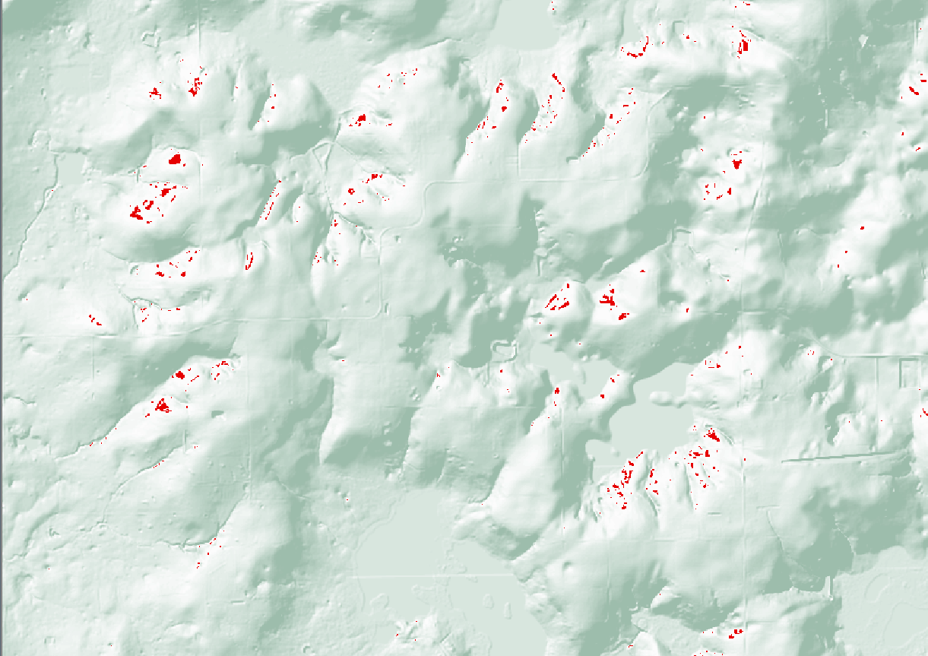
Gotchas: Setting Null Values

Slide 19
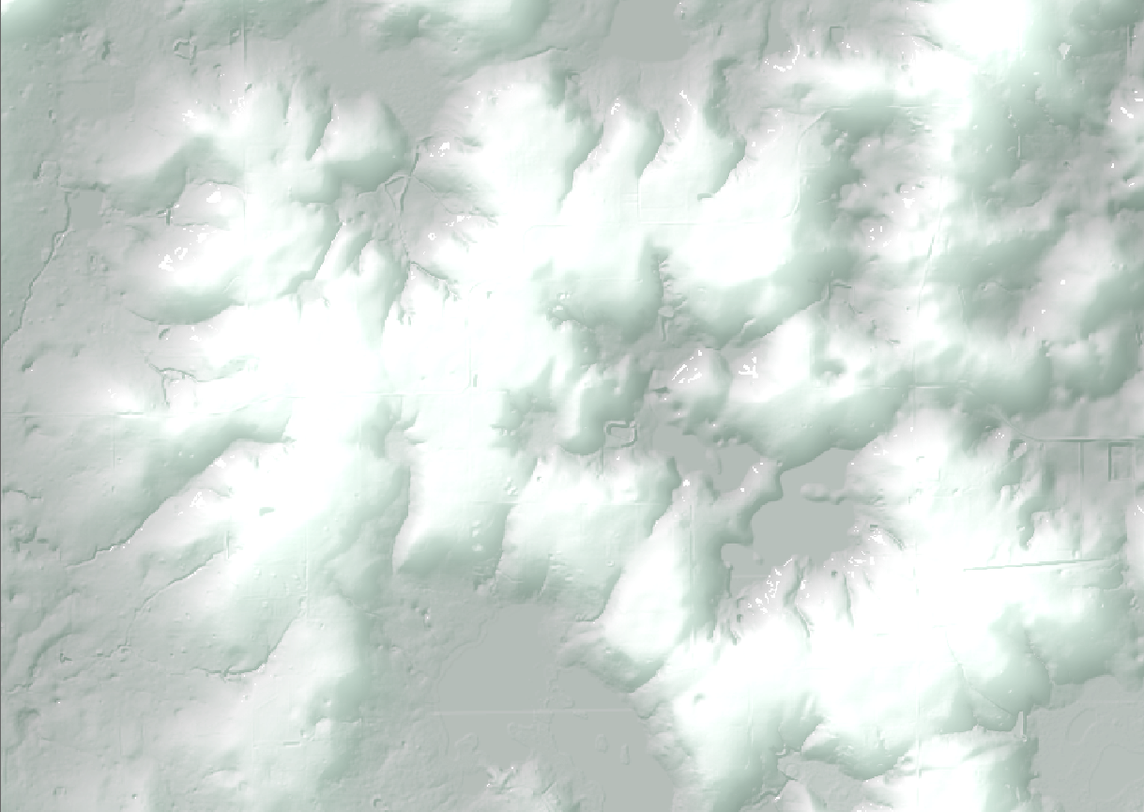
Gotchas: Setting Null Values

Slide 20
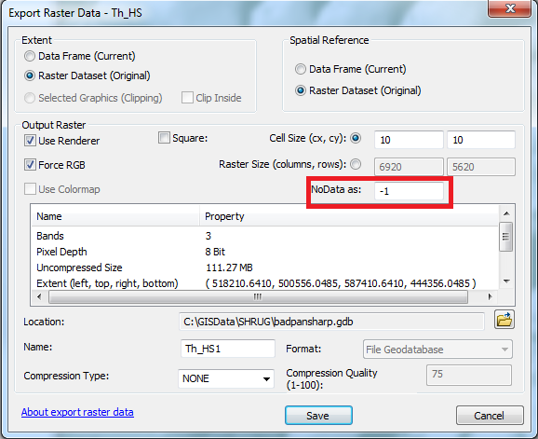
Gotchas: Set Nulls = -1

Slide 21
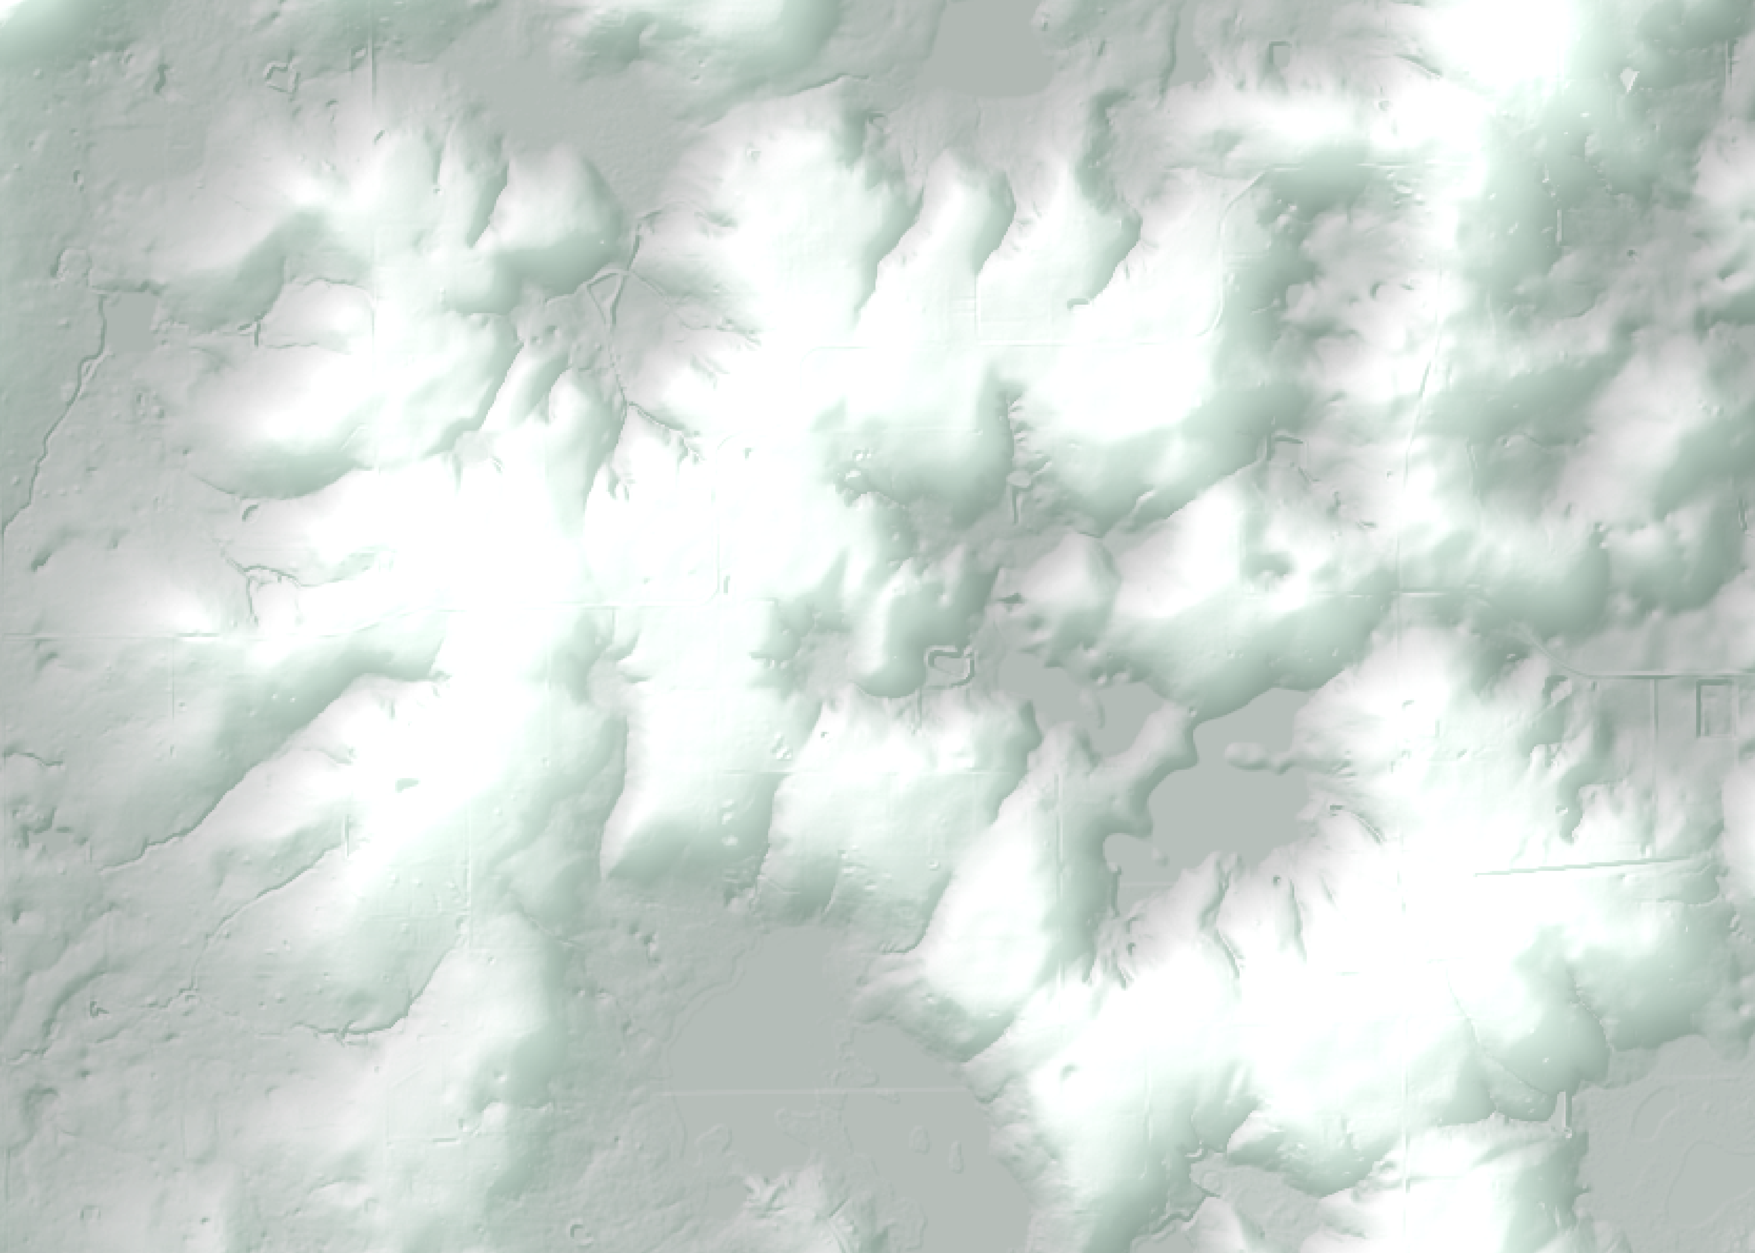
Gotchas: Set Nulls = -1

Slide 22
Data Preparation: Vector
Considerations:
What will your 3D visualization look like?
What features and Z values are required for your 3D visualization?
Are elevations stored as relative (LSE) or absolute (MSL)?
Are Z values stored as attributes or z-values?
SHP Specific Considerations:
How do I handle NULL values?
Are the first 9 characters of each column interpretable?

Slide 23
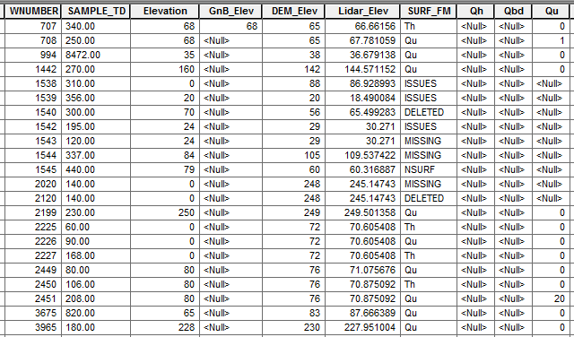
Data Preparation: Vector
Borehole Data: ArcGIS
Target: 3D Cylinders
Attributes for:
Surficial Elevation (LSE)
Depth to top of unit
No Z-values
NULL stored as NULL

Slide 24
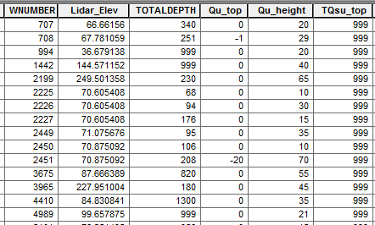
Data Preparation: Vector
Borehole Data: QGIS
Target: 3D Cylinders
Each unit now has:
NEGATIVE elevation (LSE)
POSTIVE depth to next unit (height)
NULL stored as 999

Slide 25
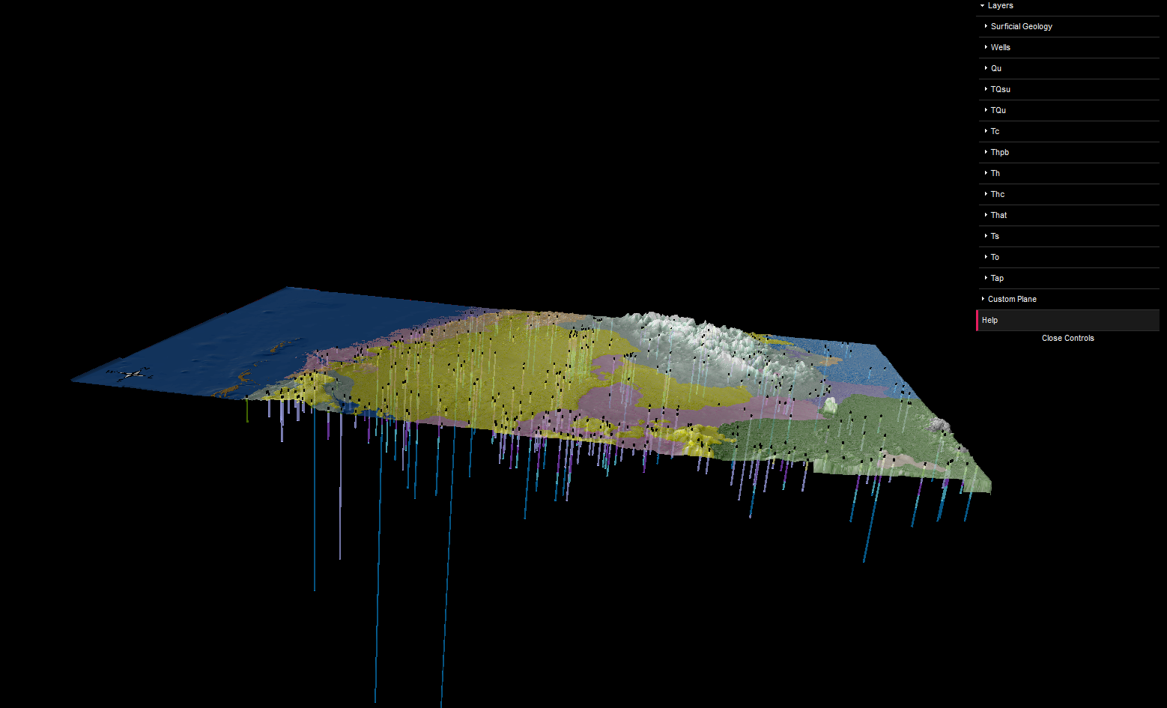
Katherine White
3D Borehole Visualization

Slide 26
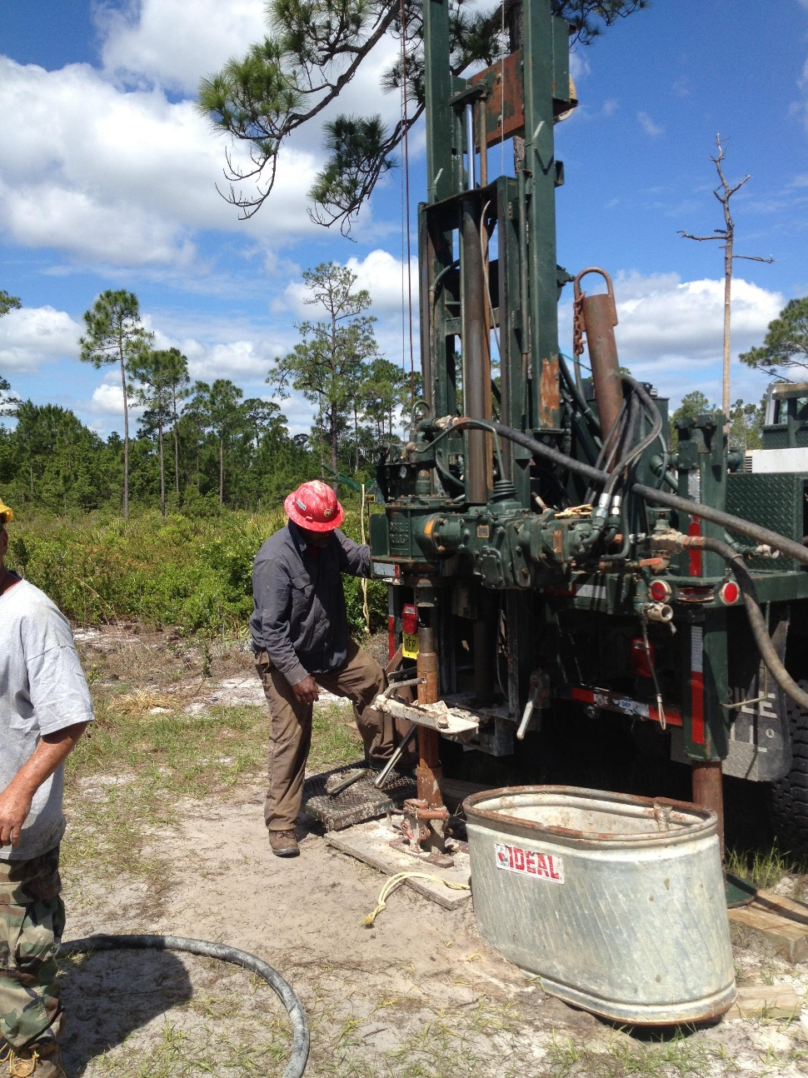
Florida Geological Survey
Boreholes
Wells drilled by FGS drillers
Core Samples
Analyzed by FGS Geologists
Notes:
Shram

Slide 27
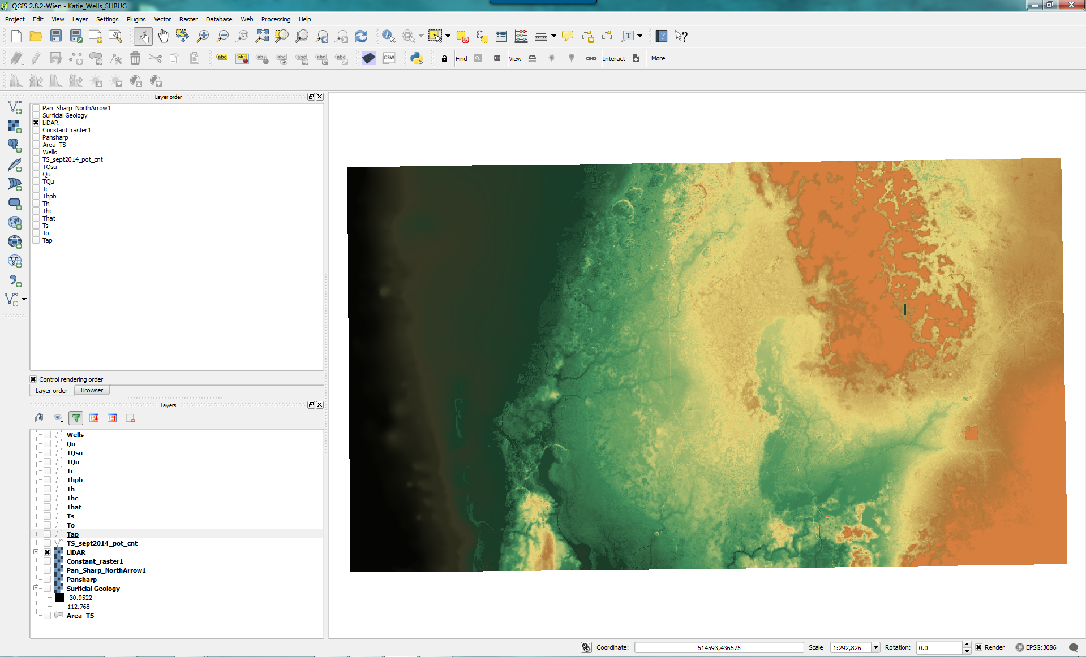
3D Borehole- QGIS Layout
Notes:
Layer Order?

Slide 28
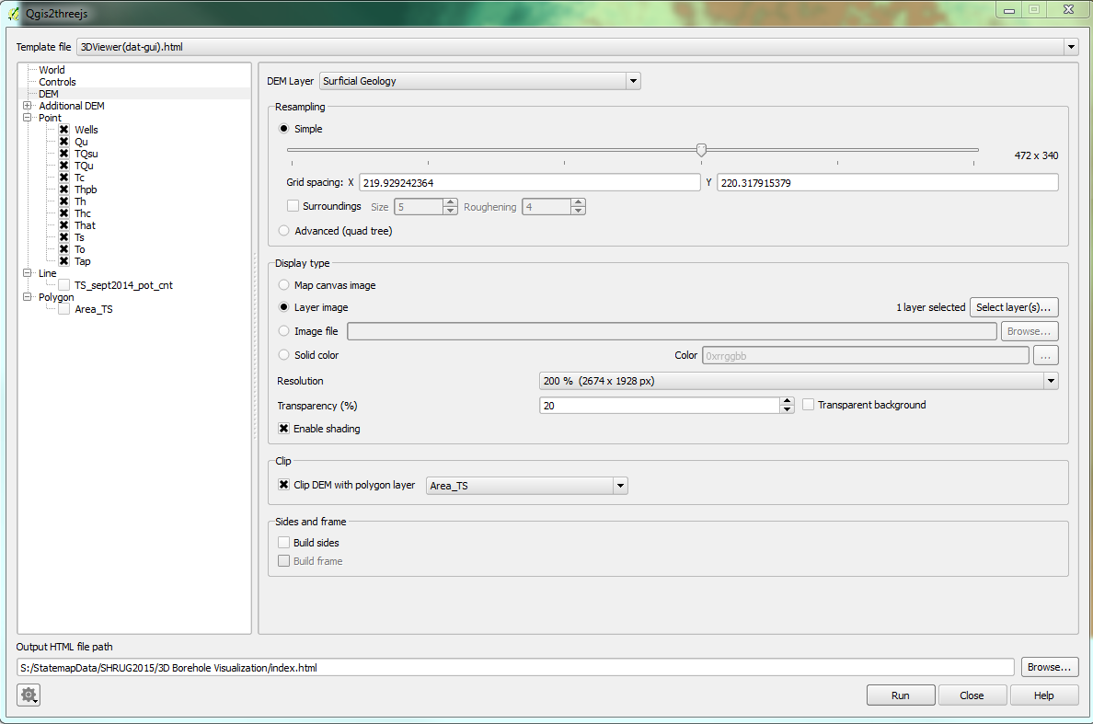
3D Borehole- Surficial Geology
Notes:
Pan sharpened layer in ARC and North Arrow added by Inkscape

Slide 29
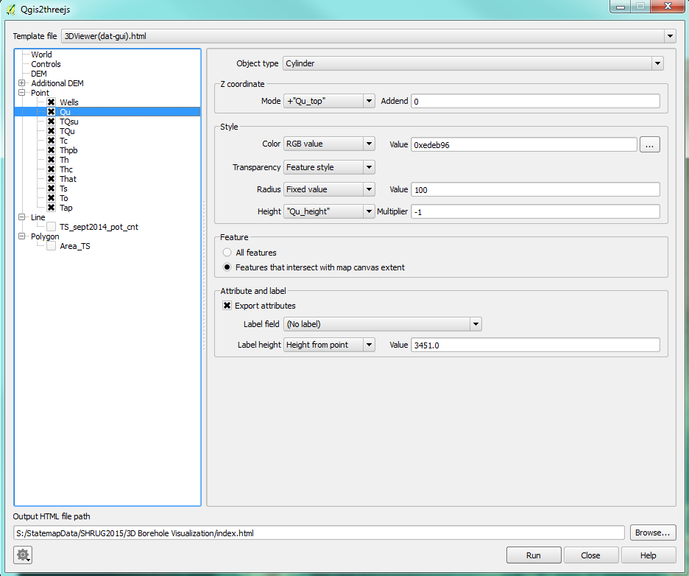
3D Borehole- Exporting to three.js
Notes:
Broke out wells according to individual formations by excluding nulls

Slide 30
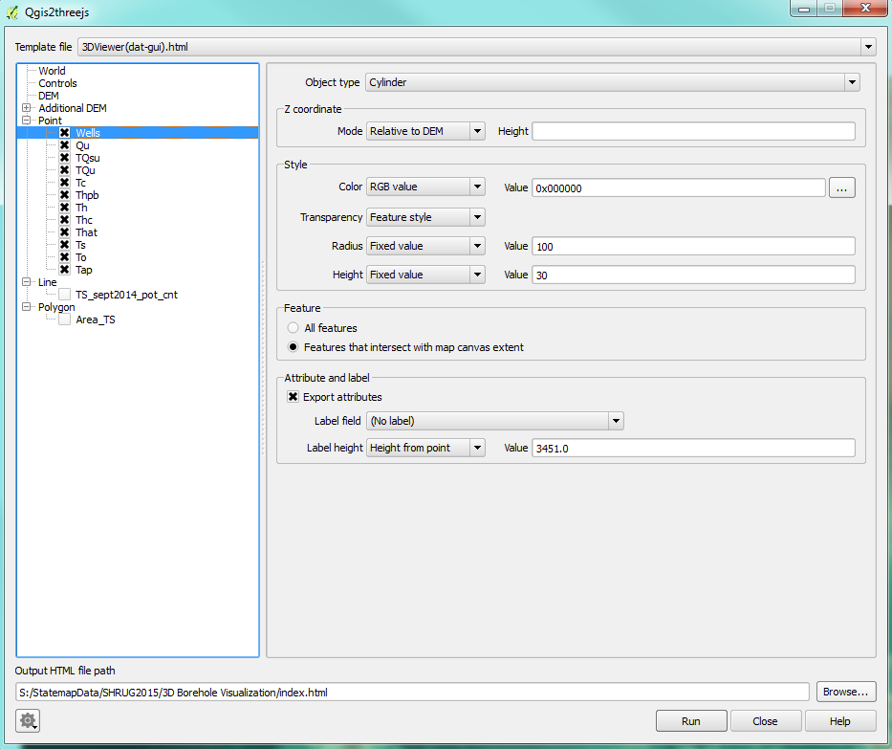
3D Borehole- Exporting to three.js
Notes:
Broke out wells according to individual formations by excluding nulls

Slide 31
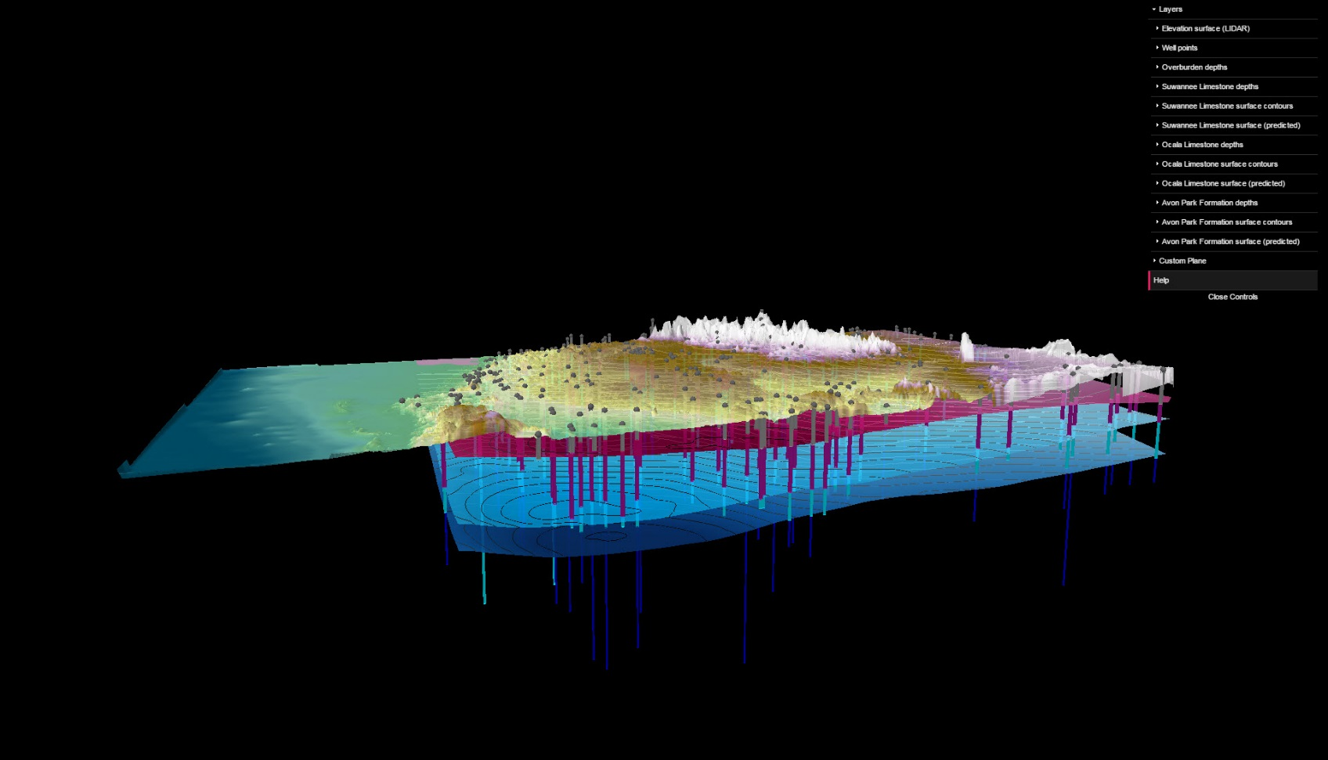
Levi Hannon
3D Surface Generation

Slide 32
3D Surface Generation
Predicted surface models built in Arc
Contours built in Arc
Z-values are relative MSL
Editing attribute tables is simple in QGIS
Overall export to Three.js is quick and easy to replicate
QGIS saves the previous export options
Option to save all setting as plain text json file

Slide 33
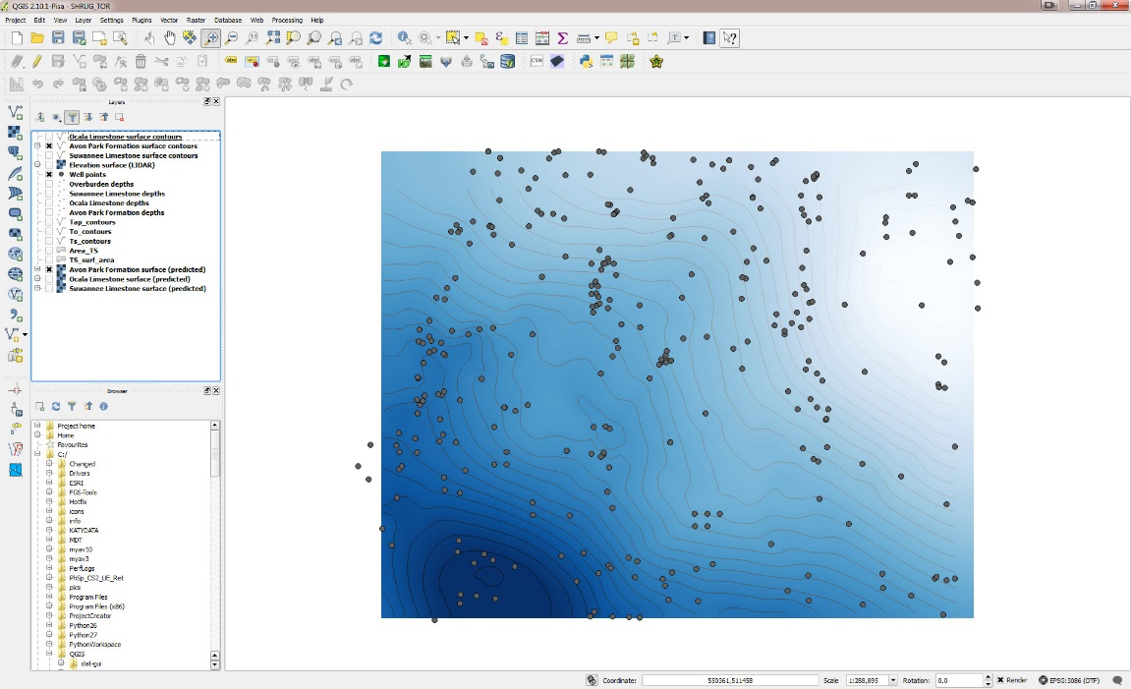
3D Surface Generation

Slide 34
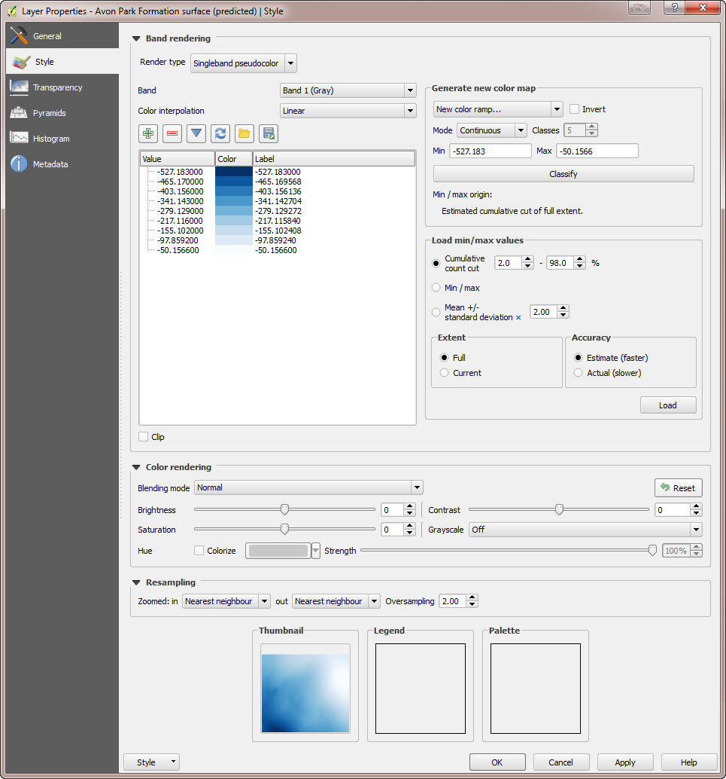
3D Surface Generation

Slide 35
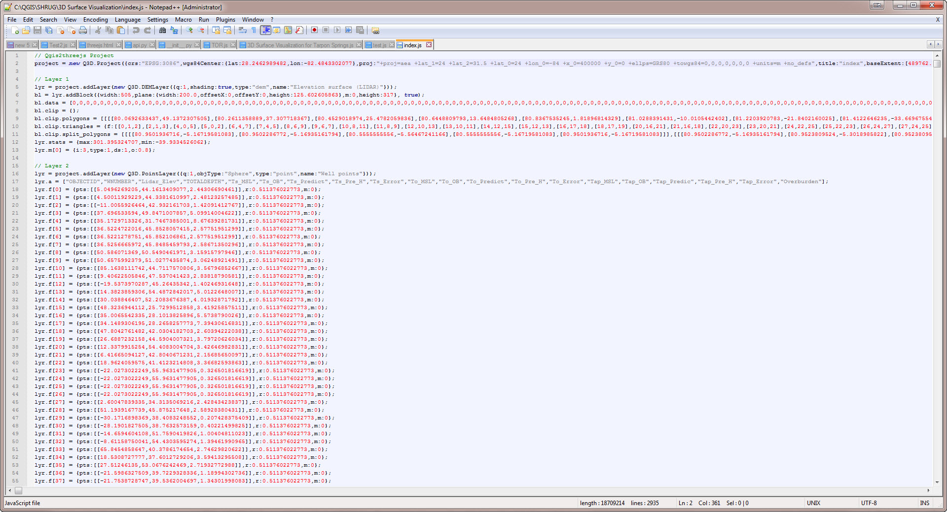
3D Surface Generation
Exports plain text JavaScript. Layer order can be changed with cut/paste

Slide 36
3D Surface Generation - Issues
Preparation of data in Arc to make “pretty” image
Masking to boundary to eliminate false barrier (“sandbox” effect)
Extents of surfaces differ based on data extent
Different extents do not play nice in Three.js
Raster images have to be resampled
Reduce resolution of LIDAR
Color ramps are a nice idea…..
….but there is no easy way to edit saved ramps without starting from scratch

Slide 37
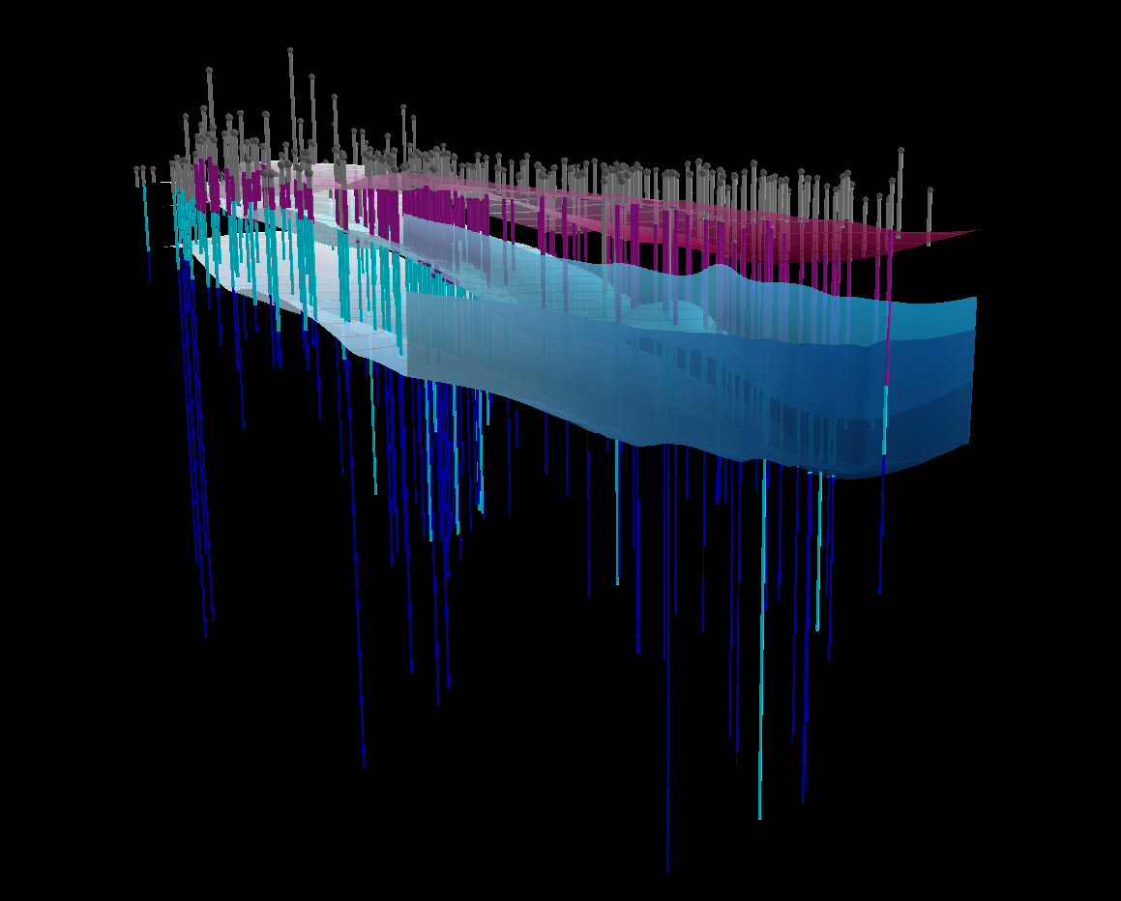
3D Surface Generation - Issues

Slide 38
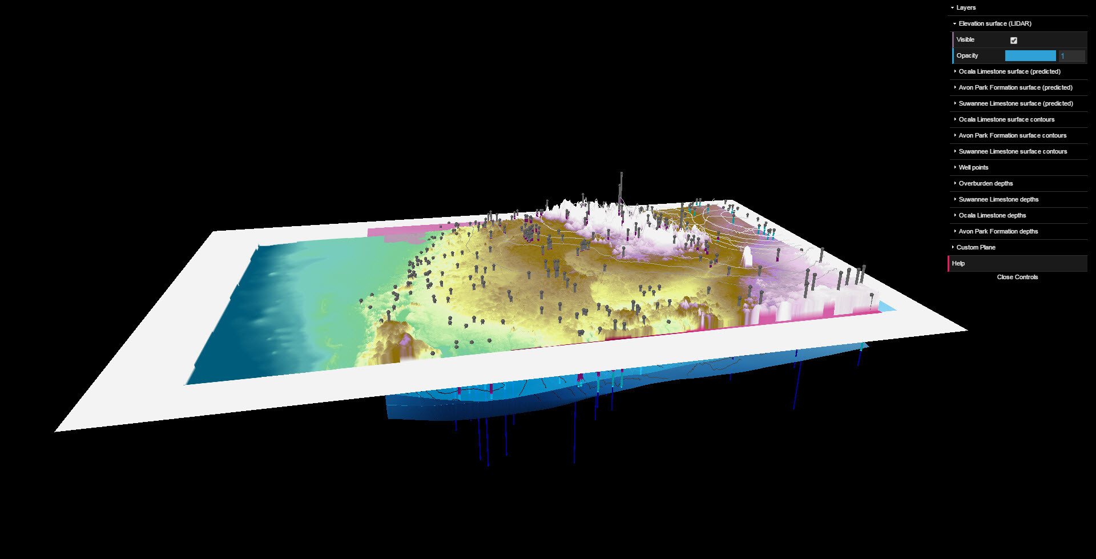
3D Surface Generation - Issues

Slide 39
Wrapping for Web Presentation
Notepad++ and CTRL-F to brand three.js visualizations with FGS and STATEMAP links
Wrapped project and presentation info into an RMarkdown document
Bonus Visualizations
Committed to github repository (gh_pages branch)
http://floridageologicalsurvey.github.io/SHRUG2015

Slide 40
The Good
Free
Simple
Straight forward
Easy to share
Easy to use in html platform
Supported by Firefox, Google Chrome and internet Explorer 11
Quick layer manipulation
Create multiple visualizations quickly and easily

Slide 41
The Bad
Not easily customizable without knowledge of javascript
“What you get is what you get…”
Struggles with large files
Can’t throw the “kitchen sink” at it
Data needs to be “neat” before inputting into the three.js plugin
Unexplained drawing failures

Slide 42
The Ugly
North Arrow and scale bar have to be photo-shopped and “creatively” generated in Arc for Three.js
Labeling
Attribute tables export as is
Unable to display only ‘desirable’ attributes
Analysis is limited to visualization
Limited visualization techniques in Three.js

Slide 43
Final Evaluation
Recommended for easy sharing of 3D visuals, esp for non tech individuals or those that lack ArcGIS software..
“Gee whiz” Visuals
Difficult to incorporate standard map elements like scale and north arrows
Might require image editing software and skills
Fairly clean open source product with minimal learning curve

Slide 44
Last Word
Is three.js suitable for professional visualization or is it just a toy?
Seth: Yes, if you are comfortable with clean data preparation and troubleshooting open source problems
Katie: Yes.
Levi: Yes, as a visualization tool. No for analysis

